Slide 1


Overview of Next Week
Blockchain Optimizations, Crypto-Tokens,
Notable Projects, Security and Anonymity
Sevgin Mustafov
Blockchain Developer & Course Developer
Academy School of Blockchain
http://kingsland.academy

Slide 2

Table of Contents
Blockchain Network Problems and Optimizations
Scalability, Performance, Transaction Prices, Sidechains
What is Ethereum and Why It Matters?
Smart Contracts and Decentralized Applications (DApps)
Notable Blockchain & Decentralized Projects
Steem, Storj, AdEX, Propy, etc.
Security and Anonymity in the Blockchain
Vulnerabilities, Wallet Security, Anonymity, etc.

Slide 3

Optimizing a Blockchain Network
Segwit, Sidechains, Off-Chain Transactions

Slide 4

Blockchain Network Optimizations
Problems
Scalability
Performance
Solutions
Off-chain Transactions
Sidechains
Examples:
EOS, IOTA, Aeternity

Slide 5

Ethereum and Crypto Tokens
Smart Contracts, Tokens and DApps

Slide 6
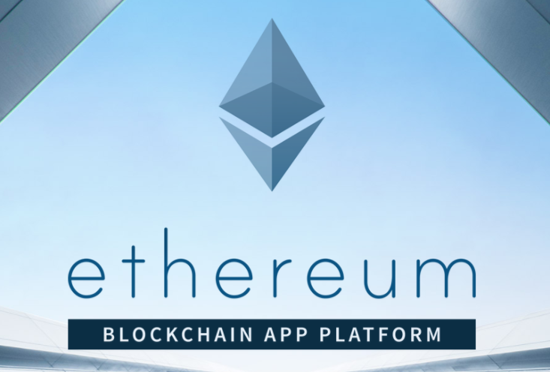
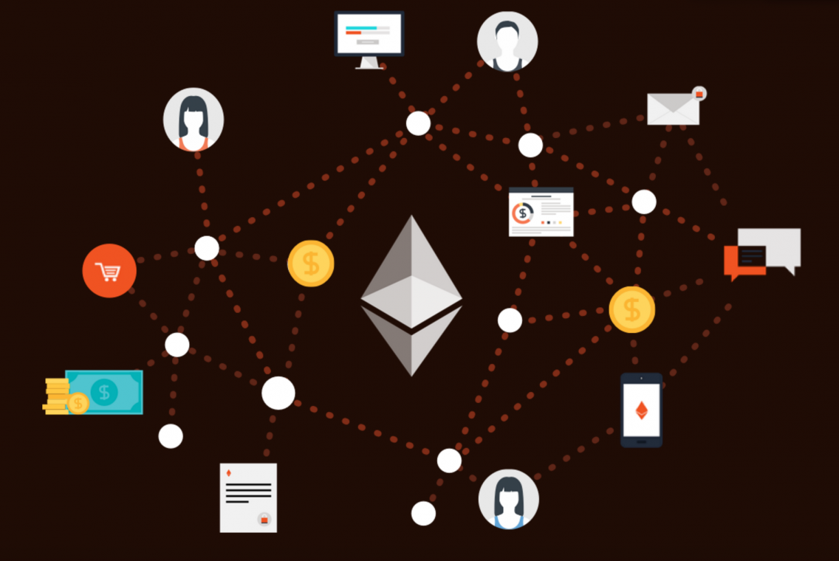
What is Ethereum and Why It Matters?
Ethereum platform
Decentralized apps platform
Run smart contracts in the EVM
Smart contracts and Solidity
ERC20 tokens and token sale events
Decentralized applications (DApps) and Web3 API

Slide 7

Notable Blockchain Projects
Storj, Steem, Augur, Gnosis, AdeX, Propy, Filecoin, LockChain

Slide 8
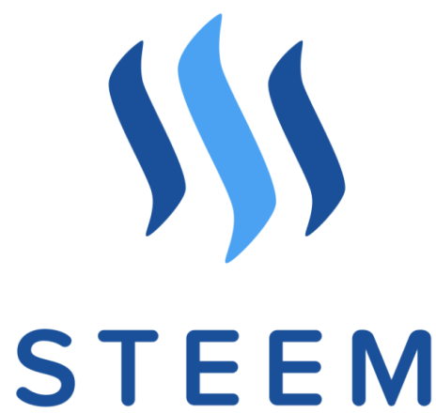



Notable Decentralized Projects
Decentralized Social Media Platforms
Decentralized Cloud Storage
Ad Exchange Platforms
Global Real Estate Store
and many more …

Slide 9

Security and Anonymity in the Blockchain Networks
Wallets Security, Zero Knowledge Proofs

Slide 10
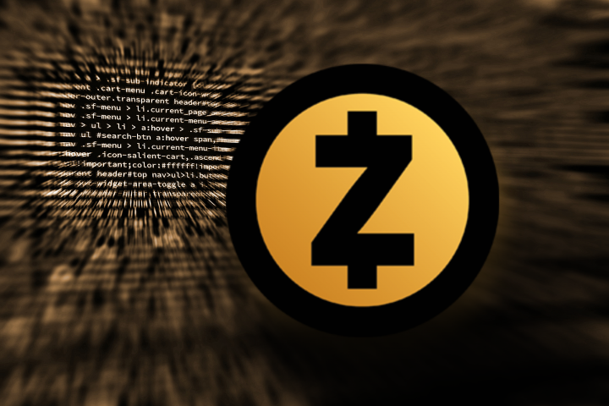



Security and Anonymity
Zero Knowledge Proofs
Wallet Security
Anonymity
Vulnerabilities

Slide 11
Overview of Next Week
http://www.kingsland.academy

